Slide 1
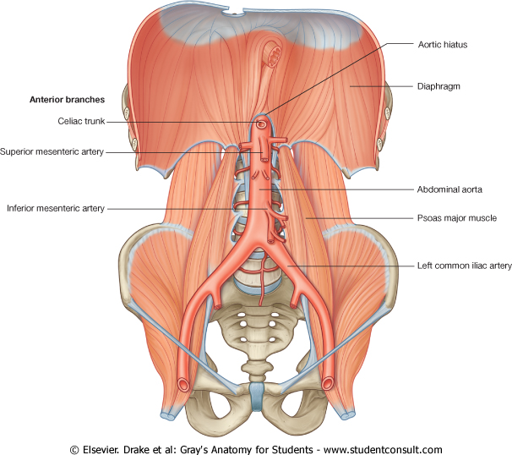
Large Blood Vessels of the Gut

Slide 2
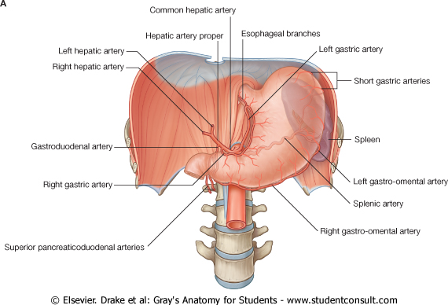
THE COELIAC TRUNK
The coeliac trunk is the artery of the foregut.
It arises from the abdominal aorta at the upper part of vertebra LI.
About half an inch long and immediately divides into the left gastric, splenic, and common hepatic arteries.
It is surrounded by the coeliac plexus of nerves which spread along its branches.

Slide 3
The left gastric artery :The smallest branch of the celiac trunk.
It ascends to the cardioesophageal junction and sends esophageal branches upward to the abdominal part of the esophagus.
It turns to the right and descends along the lesser curvature of the stomach in the lesser omentum. It supplies both surfaces of the stomach in this area and anastomoses with the right gastric artery.

Slide 4
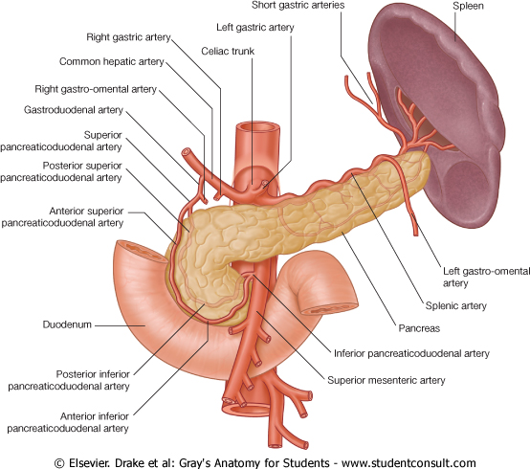
The splenic artery: The largest branch of the celiac trunk,
takes a tortuous course to the left along superior border of pancreas.
It travels in the lienorenal ligament and divides into numerous branches, which enter the hilum of the spleen.

Slide 5
The splenic artery:
it gives off numerous small branches to supply the pancreas
gives short gastric arteries, pass through the gastrosplenic ligament.
It also gives off the left gastro-omental ( gastroepiploic) artery, which runs to the right along the greater curvature of the stomach, and anastomoses with the right gastro-omental artery.

Slide 6
The common hepatic artery
runs to the right and divides into its two terminal branches, the hepatic artery proper and the gastroduodenal artery
The right gastric artery is a small branch which arises from the common hepatic artery close to the gastroduodenal artery. It runs to the left along the lesser curvature and ends by anastomosing with the left gastric artery.

Slide 7
The gastroduodenal artery may give off the supraduodenal artery before descending posterior to the superior part of the duodenum. Reaching the lower border of the superior part of the duodenum, the gastroduodenal artery divides into its terminal branches, the right gastro-omental artery and the superior pancreaticoduodenal artery.

Slide 8
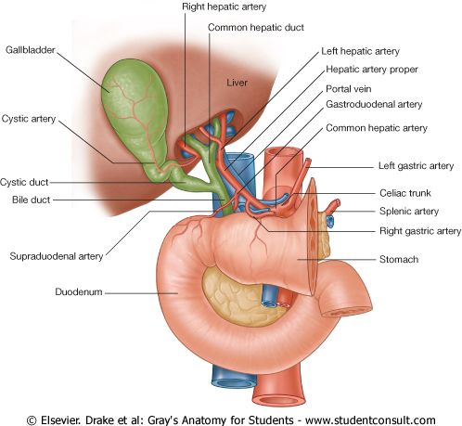
The hepatic artery proper ascends towards the liver in the free edge of the lesser omentum. It runs to the left of the bile duct and anterior to the portal vein, and divides into the right and left hepatic arteries near the porta hepatis

Slide 9
As the right hepatic artery nears the liver, it gives off the cystic artery to the gallbladder

Slide 10
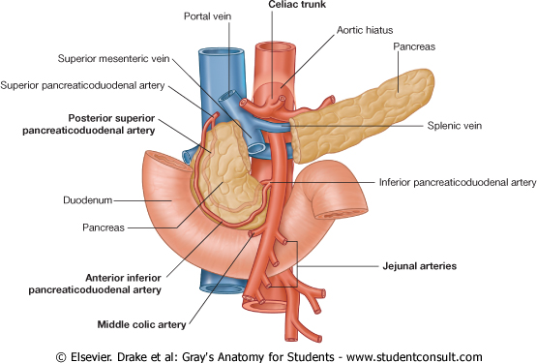
The superior mesenteric artery
Anterior branch of the abdominal aorta supplying the midgut.
It arises from the abdominal aorta immediately below the celiac artery, anterior to the lower part of vertebra LI.

Slide 11
The superior mesenteric artery
The superior mesenteric artery is crossed anteriorly by the splenic vein and the neck of pancreas. Posterior to the artery are the uncinate process of the pancreas, and the inferior part of the duodenum.

Slide 12
The superior mesenteric artery
After giving off its first branch (the inferior pancreaticoduodenal artery) the superior mesenteric artery gives off 12-15 jejunal and ileal arteries on its left side.

Slide 13
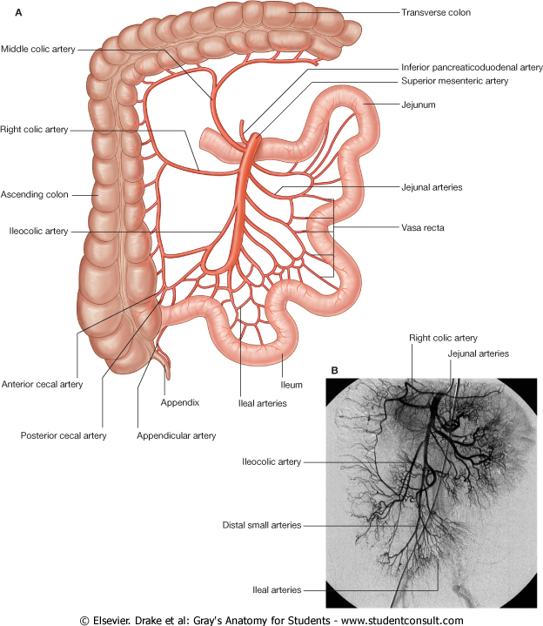
Branching from the right side of the superior mesenteric artery are three vessels-the middle colic, right colic, and ileocolic arteries-which supply the terminal ileum, cecum, ascending colon, and two-thirds of the transverse colon.

Slide 14
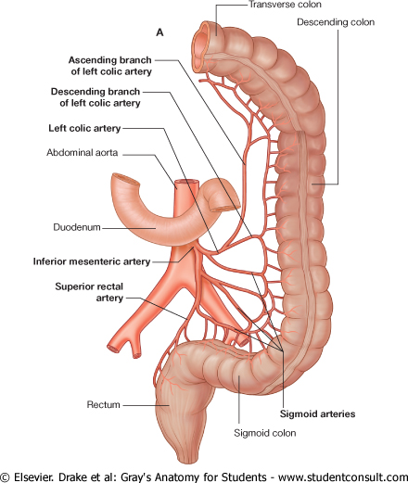
The inferior mesenteric artery
The anterior branch of the abdominal aorta that supplies the hindgut.
It is the smallest of the three anterior branches of the abdominal aorta and arises anterior to the body of vertebra LIII.

Slide 15
The inferior mesenteric artery
Initially, the inferior mesenteric artery descends anteriorly to the aorta and then passes to the left as it continues inferiorly.

Slide 16
The inferior mesenteric artery
Its branches include the left colic artery, several sigmoid arteries, and the superior rectal artery (terminal branch of the inferior mesenteric artery).

Slide 17
The inferior mesenteric artery
It Supplying the distal 1/3 of the transverse colon, decending colon, sigmoid colon, rectum and upper part of anal canal.

Slide 18
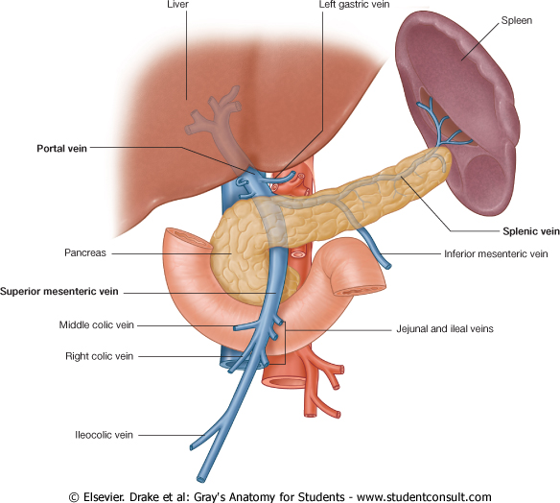
Portal vein
Formed by the union of the splenic vein and the superior mesenteric vein posterior to the neck of the pancreas at the level of vertebra LII.

Slide 19
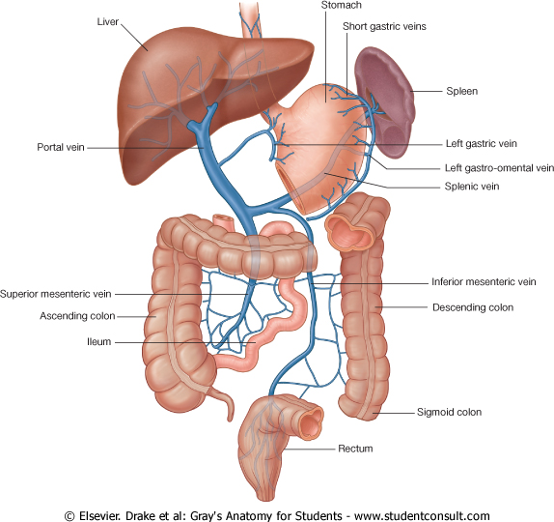
Deliver blood from these structures to the liver.
Drain spleen, pancreas, gallbladder, and the abdominal part of the gastrointestinal tract, except for the inferior part of the rectum

Slide 20
Portal vein
Ascending towards the liver, the portal vein passes posterior to the superior part of the duodenum and enters the free margin the lesser omentum, anterior to the epiploic foramen

Slide 21
On approaching the liver, the portal vein divides into right and left branches, which enter the liver parenchyma

Slide 22
Once blood passes through the hepatic sinusoids, it passes through progressively larger veins until it enters the hepatic veins, which return the venous blood to the inferior vena cava just inferior to the diaphragm.

Slide 23
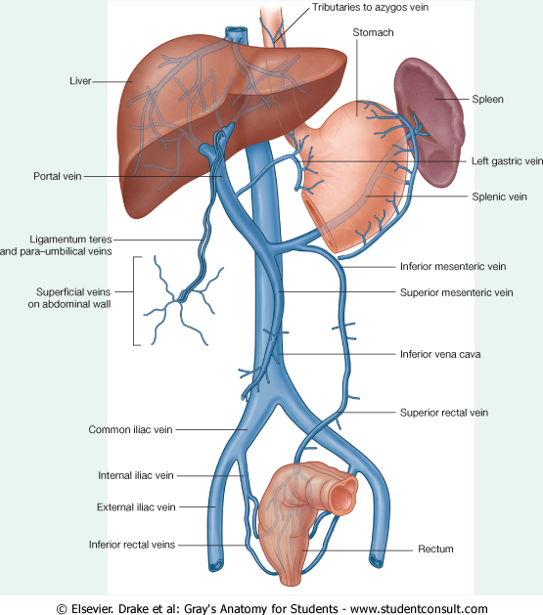
Tributaries to the portal vein include:
right and left gastric veins draining the lesser curvature of the stomach and abdominal esophagus;
cystic veins from the gallbladder;

Slide 24
Tributaries to the portal vein include:
;
the para-umbilical veins, which are associated with the obliterated umbilical vein and connect to veins on the anterior abdominal wall

Slide 25
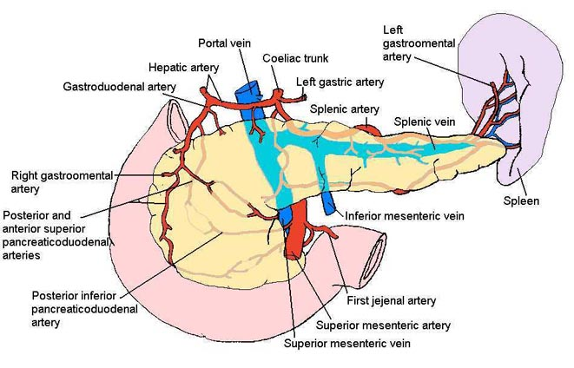
Splenic vein
Forms from numerous smaller vessels leaving the hilum of the spleen.
It passes to the right, passing through the splenorenal ligament
Continuing to the right, it is in contact with the body of the pancreas as it crosses the posterior abdominal wall
Posterior to the neck of pancreas, the splenic vein joins the superior mesenteric vein to form the portal vein.

Slide 26
Tributaries to the splenic vein include:
short gastric veins from the fundus and left part of the greater curvature of the stomach;
the left gastro-omental vein from the greater curvature of the stomach;
pancreatic veins draining the body and tail of pancreas;
usually the inferior mesenteric vein.

Slide 27
The superior mesenteric vein
It begins in the right iliac fossa
ascends in the mesentery of small intestine to the right of the superior mesenteric artery.
Posterior to the neck of the pancreas, joins the splenic vein to form the portal vein.

Slide 28
Tributaries to the superior mesenteric vein
jejunal, ileal, ileocolic, right colic, and middle colic veins
the right gastro-omental vein, draining the right part of the greater curvature of the stomach;
the anterior and posterior inferior pancreaticoduodenal veins.

Slide 29
The inferior mesenteric vein
It begins as the superior rectal vein and ascends, receiving tributaries from the sigmoid veins and the left colic vein.
Drains blood from the rectum, sigmoid colon, descending colon, and splenic flexure.

Slide 30
The inferior mesenteric vein
Continuing to ascend posterior to the body of the pancreas and usually joins the splenic vein.
Somtimes, it ends at the junction of the splenic and superior mesenteric veins or joins the superior mesenteric vein.

